Slide 1
On Link Prediction in Knowledge Bases: Max-k Criterion and Prediction Protocols
Jiajie Mei¹, Richong Zhang¹, Yongyi Mao², Ting Deng¹
¹Beihang University, China
²University of Ottawa, Canada
Notes:
3 messages
My name & where do I come from
What our work is about
Who else engaged in

Slide 2
Knowledge Base (KB)
Emerging KBs: Freebase, YAGO, DBpedia
KB: collection of facts
Factual triple
$\left(University of Michigan, isLocatedIn, Ann Arbor\right)$
KB completion: fill in missing facts
$$↑$$
$$↑$$
$$↑$$
head entity
relation
tail entity
Notes:
4 messages
The emerging of KBs has stimulated the development of novel information-retrieval applications with great commercial or societal impact.
The KBs are usually presented as a collection of knowledge triples.
Example: University of Michigan, isLocatedIn, Ann Arbor
Head entity, relation, tail entity.

Slide 3
Link Prediction
Link prediction tasks
Head prediction: $\left(?,r,t\right)$
e.g. $\left(?, isCapitalOf, France\right)$
Tail prediction: $\left(h,r,?\right)$
e.g. $\left(The Interstellar, isDirectedBy, ?\right)$
Score function: $g\left(h,r,t\right)$
Likelihood that $\left(h,r,t\right)$ is factual
Involves representation of KB
SOTA: TransE, TransH, ComplEx, Analogy, ProjE, ConvE, etc
Notes:
6 messages
The existing KBs are far from complete. → KBC
Most commonly the KB completion problem is posed as link prediction.
Two kinds KBs.
The goal of link prediction.
Typical form of link prediction.
We consider tail prediction.

Slide 4
Top-k Criterion
Procedure
Pick the cutoff value k
For each $\left(h,r,?\right)$, rank all $\left(h,r,t^{′}\right)$ by scores and return entities $t^{′}$ with top-k scores
Metrics:
$\overline{RNK}$ (mean rank)
$MRR$ (mean reciprocal rank)
$HIT@k$: the fraction of testing triples that has the rank within top-k
“Filtered” version: $\overline{fRNK}$, $fHIT@k$, $fMRR$
Notes:
2 messages
For all link prediction methods, the top-k criterion is used.
Procedure

Slide 5
Limitations
Consider $k=10$ (customary)
Case 1: $\left(Paris, isCapitalOf, ?\right)$
Low precision
Case 2: $\left(Paris, isBirthplaceOf, ?\right)$
Low recall
Answer Multiplicity: The number of correct answers for $\left(h,r,?\right)$
Notes:
4 messages
The first case is the model is asked to answer Washington D.C. is the capital of which country? Low precision.
The second case if the model is asked to answer the Michigan is the birthplace of whom? Low recall
We investigate some popular KB datasets to see how different link prediction tasks can be in terms of the number of correct answers.
Using top-k criterion is hard to handle these high variabilities in link prediction tasks.

Slide 6
Answer Multiplicity
Approximately estimated over training and validation sets
Hard to select a global k over all tasks
The problem exists in wide classes
Query answering & multi-label classification
Notes:
4 messages
The first case is the model is asked to answer Washington D.C. is the capital of which country? Low precision.
The second case if the model is asked to answer the Michigan is the birthplace of whom? Low recall
We investigate some popular KB datasets to see how different link prediction tasks can be in terms of the number of correct answers.
Using top-k criterion is hard to handle these high variabilities in link prediction tasks.

Slide 7
Max-k Criterion
Procedure
Pick k
For each $\left(h,r,?\right)$, return k entities at most
Metrics
Precision, recall & F1: $P@k$, $R@k$, $F1@k$
$P@k=\frac{\#\left\{correctly predicted answers\right\}}{\#\left\{predicted answers\right\}}$
Averaged over all tasks
Filtered version: $fP@k$, $fR@k$, $fF1@k$
Notes:
2 messages
The procedure of max-k criterion
The difference between top-k and max-k criteria

Slide 8
Justification
An oracle model: knows all the correct answers
How would he answer $\left(h,r,?\right)$
Suppose there are $T$ correct answers to this task
Decision of the oracle under the two criteria
Easy to check for the oracle:
The precision, recall and F1 performance: max-k $≥$ top-k
This should justify the use of max-k
 | Top-k | Max-k
If $T≤k$ | $T$ $√$ and $k−T$ $×$ | $T$ $√$
If $T>k$ | $k$ $√$ | $k$ $√$

Slide 9
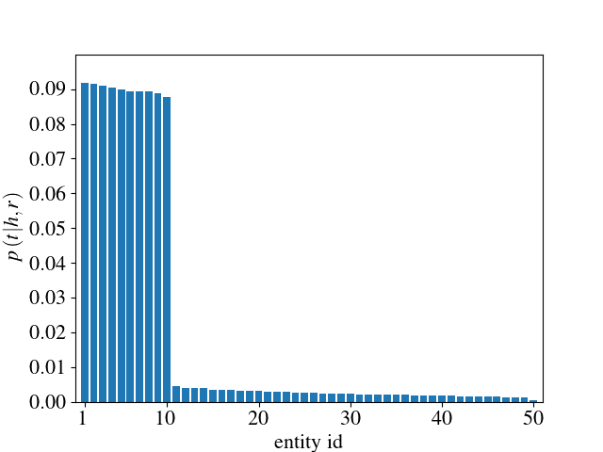
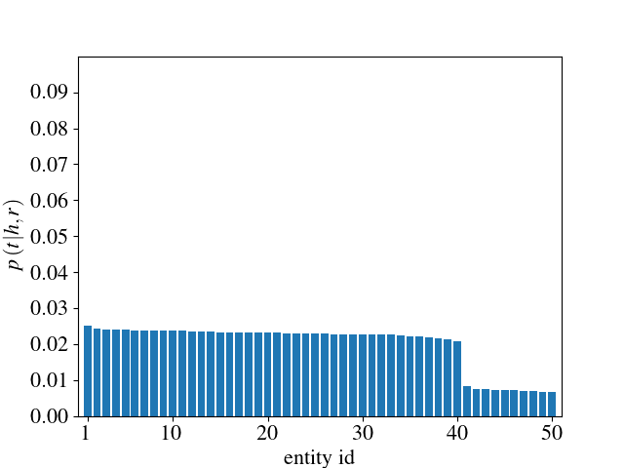
Prediction Protocols
Suppose $g\left(h,r,t\right)=p\left(t|h,r\right)$ and $k=20$
Assume $p\left(t|h,r\right)$ satisfies $p\left(1|h,r\right)≥…≥p\left(N|h,r\right)$
Consider the following two special cases
Three protocols: TopK, Sampling and Greedy

Slide 10
TopK Protocol
Def: return k entities with the highest scores
Left & right figs: return the leftmost 20 entities
Trivial, proposed only to compare top-k and max-k under the same framework
Notes:
2 messages
TopK protocol is only used to compare the top-k and max-k criterion in the same framework.
We introduce two more protocols which are typical of max-k criterion.

Slide 11
Sampling Protocol
Desired behaviors of this protocol:
Left fig: we desire the leftmost 10 entities are selected
Right fig: we desire arbitrarily 20 entities among the leftmost 40 ones are selected
Notes:
3 messages
In the left figure, we see that the left 10 entities have dominating probabilities. We desire these 10 entities are selected as answers.
In the right figure, we see that none of the probability values dominate but the left 40 entities have significantly larger probability than the remaining entities. We desire the selected answers are 20 entities in these 40 entities.
Desire such a behavior, we propose the following sampling protocol.

Slide 12
Sampling Protocol
Def: sample k entities from $p\left(t|h,r\right)$ and return the distinct entities as the answers
Optimality?
Oracle distribution: put equal non-zero probabilities on the correct answers and zero on the wrong answers
Theorem 1 in the paper is wrong.
Convert scores to probabilities
$p\left(t|h,r\right)=\frac{\exp\left(α∗g\left(h,r,t\right)\right)}{\sum_{t^{′}}{\exp\left(α∗g\left(h,r,t^{′}\right)\right)}}$
$α$ adjusts the contrast of $p\left(t|h,r\right)$
$α$ might be learned
Notes:
2 messages
The definition of the sampling protocol
The theorem 1 claims that using sampling protocol will not hurt the performance of the oracle.
The sampling protocol is optimal in an average sense.

Slide 13
Greedy Protocol
Def
Find the value $\tilde{k}$ such that $p\left(\tilde{k}|h,r\right)≥\frac{1}{k}$ and $p\left(\tilde{k}+1|h,r\right)<\frac{1}{k}$. If no such $\tilde{k}$ exists, let $\tilde{k}=0$.
Calculate $q$ as the nearest integer to $k−\sum_{i=1}^{\tilde{k}}{k∙p\left(i|h,r\right)}$
Return the entity $1,2,…,\tilde{k},\tilde{k}+1,…,\tilde{k}+q$
$$\frac{1}{k}$$
$$\frac{1}{k}$$
$\tilde{k}$=10
$$q=2$$
$$\tilde{k}=0$$
$$q=20$$
$$1,…,12$$
$$1,…,20$$
Notes:
3 messages
The greedy protocol is motivated by the proof sketch just shown.
For asymptotically large k, the sampling and the greedy protocols are equivalent.
The greedy protocol can be viewed as implementing a top-k criterion but with self-determined k value, i.e., k tilde plus q.

Slide 14
Asymptotic Analysis of Sampling Protocol
Consider k is asymptotically large.
Theorem 2
Suppose
$p\left(1|h,r\right)≥…≥p\left(N|h,r\right)$
$p\left(\tilde{k}|h,r\right)≥1/k$ and $p\left(\tilde{k}+1|h,r\right)<1/k$
If no such $\tilde{k}$ exists, let $\tilde{k}$ be 0
Then the number of answers $T^{′}$ obtained by the sampling protocol satisfies
$T^{′}\underset{→}{p}\left(k−\sum_{i=1}^{\tilde{k}}{k∙p\left(i|h,r\right)}\right)+\tilde{k}$, as $k→∞$
$$≈q$$
Notes:
2 messages
Here we show an asymptotic property of the sampling protocol.
We see that when k asymptotically large, how many answers will be returned and what these answers are. As the theorem 2 shows.

Slide 15
Proof Sketch
Weak law of large number, $k→∞$, $P→1$
The $k$ entities (sequence) drawn from the $p\left(t|h,r\right)$ contains:
If $k∙p\left(i|h,r\right)≥1$, the sequence contains entity $i$ with $P→1$.
The largest $i$ satisfying $k∙p\left(i|h,r\right)≥1$ is precisely $\tilde{k}$.
Entity ID | Number
$$1$$ | $$k∙p\left(1|h,r\right)$$
$$2$$ | $$k∙p\left(2|h,r\right)$$
$$⋮$$ | $$⋮$$
$$N$$ | $$k∙p\left(N|h,r\right)$$
Notes:
3 messages
By the weak law of large number, in the large k limit, with probability approaching 1, the k entities drawn from …
If k times p of i given h and r is greater or equal than 1, then the drawn entities contain entity i with the probability approaching 1
The largest i satisfying this inequation is k tilde.

Slide 16
Proof Sketch
If $\tilde{k}=0$, i.e., for all $i$, we have $k∙p\left(i|h,r\right)<1$
With $P→0$, there exist duplicate entities in the sequence.
$T^{′}\underset{→}{p}k$
If $\tilde{k}>0$
The sequence contains $1,2,…,\tilde{k}$ with $P→1$.
Remove entities $1,2,…,\tilde{k}$ from the sequence.
The remaining sequence has length $q$ arbitrarily close to $k−\sum_{i=1}^{\tilde{k}}{k∙p\left(i|h,r\right)}$.
Similarly, the remaining sequence contains precisely $q$ distinct entities ($P→1$).
$T^{′}\underset{→}{p}\tilde{k}+\left[k−\sum_{i=1}^{\tilde{k}}{k∙p\left(i|h,r\right)}\right]$
Notes:
2 messages
If k tilde equals zero, then
If k tilde is greater than zero

Slide 17
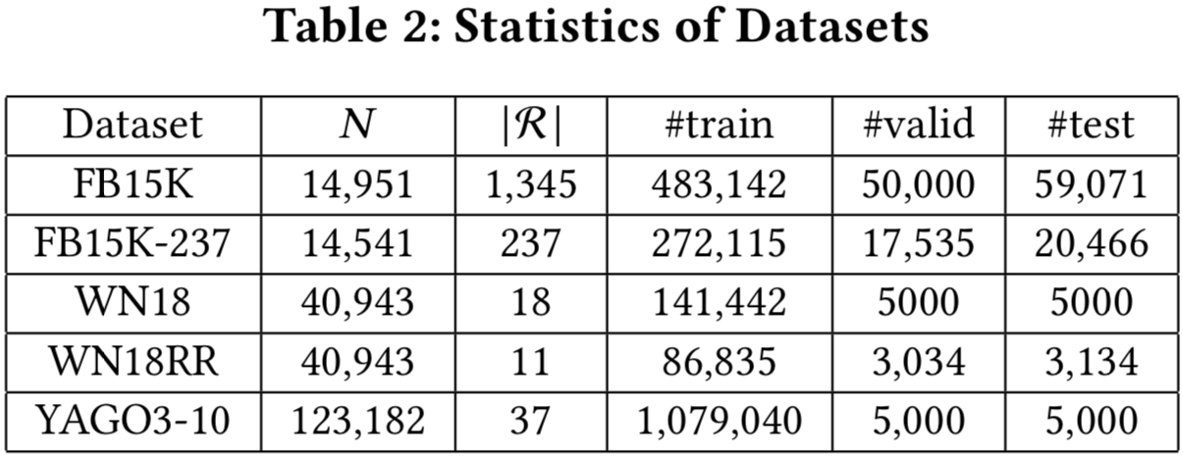
Experiments
Datasets
FB15K, FB15K-237, WN18, WN18RR, YAGO3-10
Link prediction models
TransE, ComplEx, Analogy, ProjE
Notes:
2 messages
Representative datasets we use
Representative models we use

Slide 18
Experiments
Content
Select $α$ such that $fF1@10$ is the best among $\left\{0.2,0.5,1,2,5,10,20,50\right\}$
Compare models under top-k metrics and max-k metrics
No correlations are observed
Compare Sampling, Greedy, TopK Protocols and theoretical limits
Compare models and datasets under the max-k criterion
Notes:
1 message
1. The content of our experiments

Slide 19
Results
Compare Sampling, Greedy, TopK Protocols and theoretical limits (e.g. “Analogy, FB15K-237, F1”)

Slide 20
Results
Compare models and datasets under the max-k criterion
e.g. Analogy on WN18, ProjE on YAGO3-10

Slide 21
Conclusion
We present the max-k criterion to replace top-k.
Two protocols with strong theoretical justifications are proposed for max-k.
Max-k is shown to be advantageous.

Slide 22
Thanks!
Q & A

